Slide 1
Recipient Heart Transplant Outcome
Tharun byreddy

Slide 2
Contents:
About DHS & SRTR
Objective
Data Cleaning
Exploratory Data Analysis (EDA)
Data Visualization
Data Preprocessing
Impute Missing Data
Feature Engineering
Data Transformation
Multicollinearity
Modeling
Data Partitioning
Model Implementation
Validation (Results and C–statistic)
Conclusion

Slide 3
DHS (Donor Heart Study) and SRTR Registry
Left ventricular dysfunction in potential donors meeting brain death criteria often results in nonuse of donor hearts for transplantation, yet little is known about its incidence or pathophysiology. Resolving these unknowns was a primary aim of the DHS (Donor Heart Study), a multisite prospective cohort study.
Scientific Registry of Transplant Recipients (SRTR): To provide advanced statistical and epidemiological analyses related to solid organ allocation and transplantation in support of the Department of Health and Human Services and its agents in their oversight of the national organ transplantation system.

Slide 4
Objective & Data description
To build a prediction model for recipient composite outcome (death/graft failure/re-transplantation at 1-year) using recipient and donor characteristics.
Raw data Consists of 10,882 observations and 150 feature variables (final model included 86 features that is pre-specified by the PI).
Each observation represents a recipient and each column variable represents it’s attributes.
The primary outcome is a binary variable (1 indicates either recipient died or had a graft failure or was retransplanted within a year post initial transplantation, otherwise will be 0)
Modified and removed unnecessary columns.

Slide 5
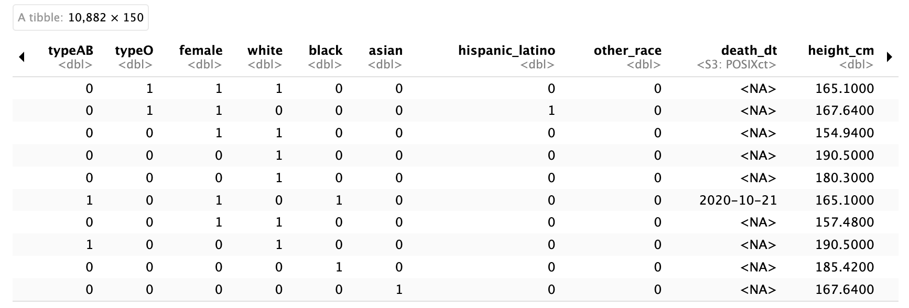
Predictors/Features
Donor characteristics
Recipient characteristics
Demographics: age, race, education,…..
Clinical or physiological characteristics: BMI, Diabetes…
Behavioral : Smoking,……

Slide 6
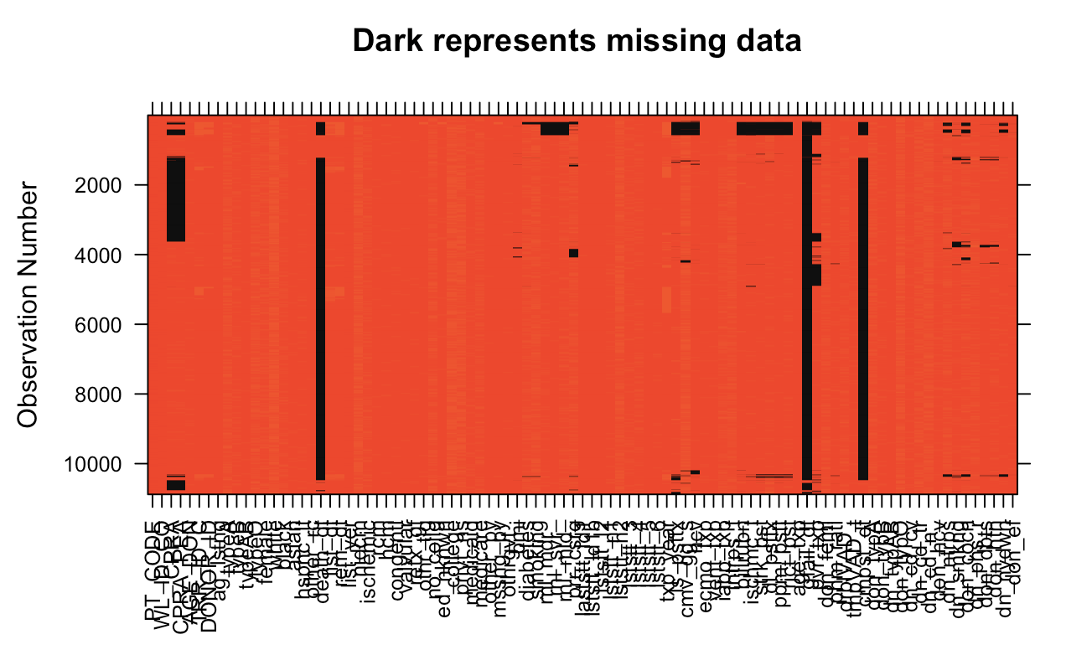
Missing Data

Slide 7
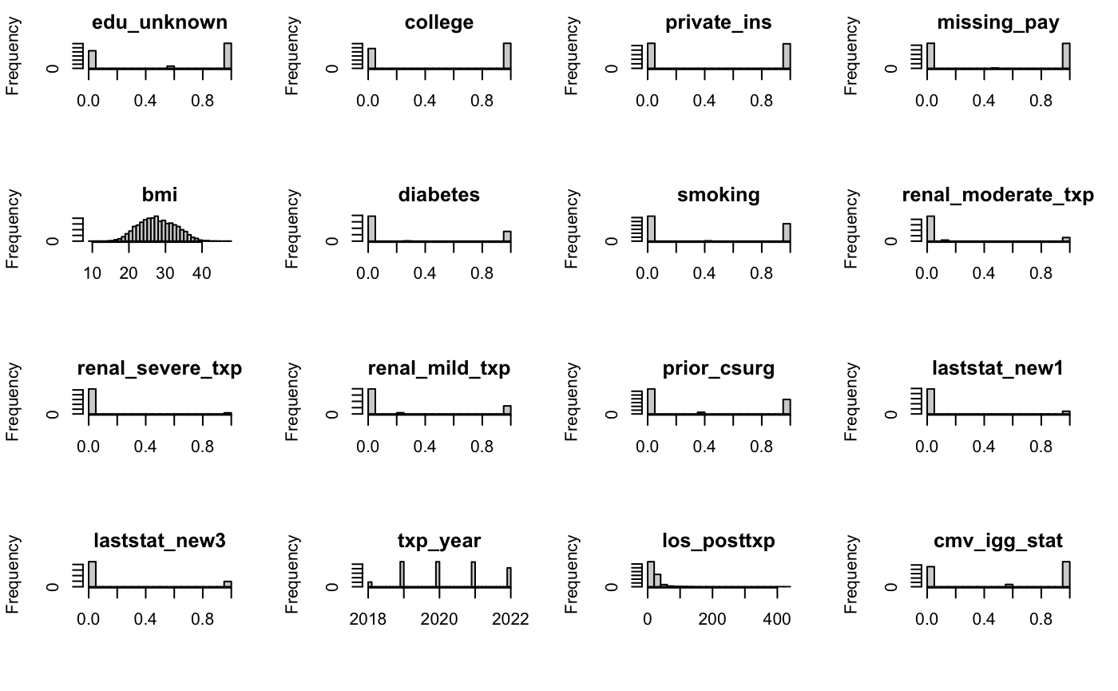
Distribution of the features
Data Visualization: Based on summary of the data and visualizing distributions of variables, found outliers and removed them from the dataset.

Slide 8
Data Preprocessing (Cleaning and Validation)
Outcome variable is created and categorized based on two feature variables (txp_dt and composite_dt).
Missing value Imputation: For Numerical/Continuous Variables – Mean substitution & For Categorical variables – Mode substitution. (We will do multiple imputation in future)
Feature Engineering: Combining some features and encoding into a new categorical variable ex. Race, college/no_college etc.. and removing the existence variables.
Data Transformation: Log Transform of some variables to normalize data as they are highly right skewed.

Slide 9
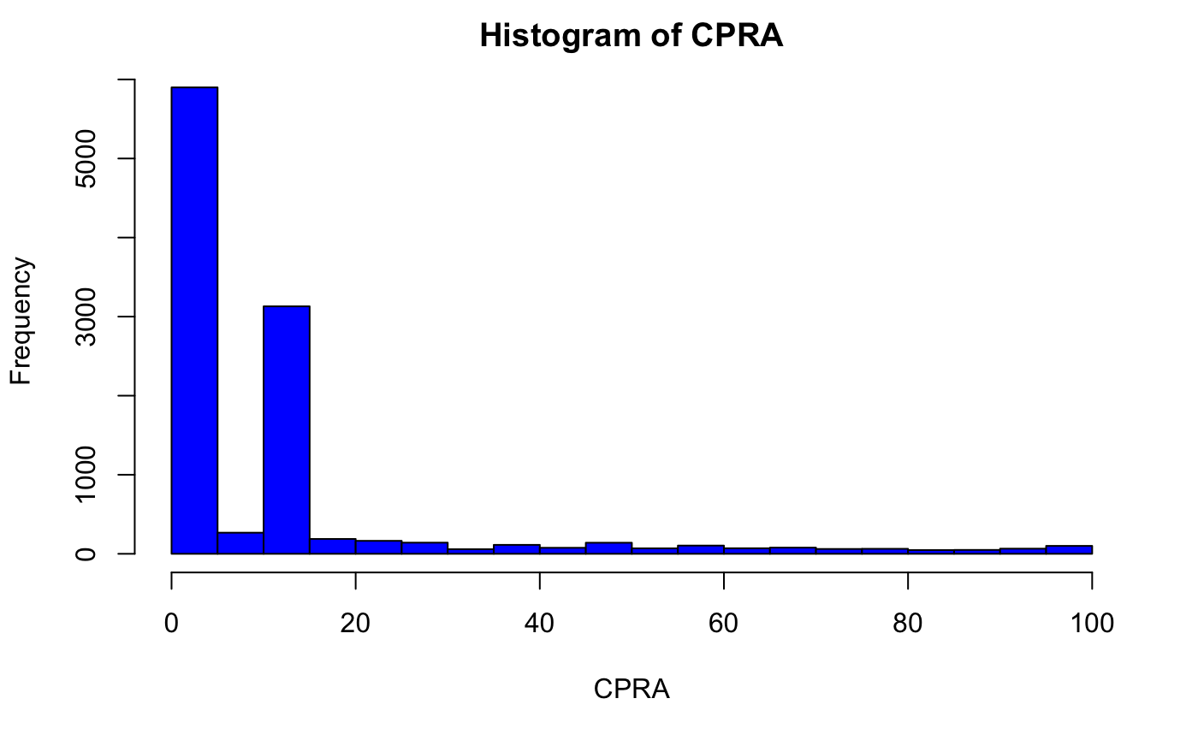
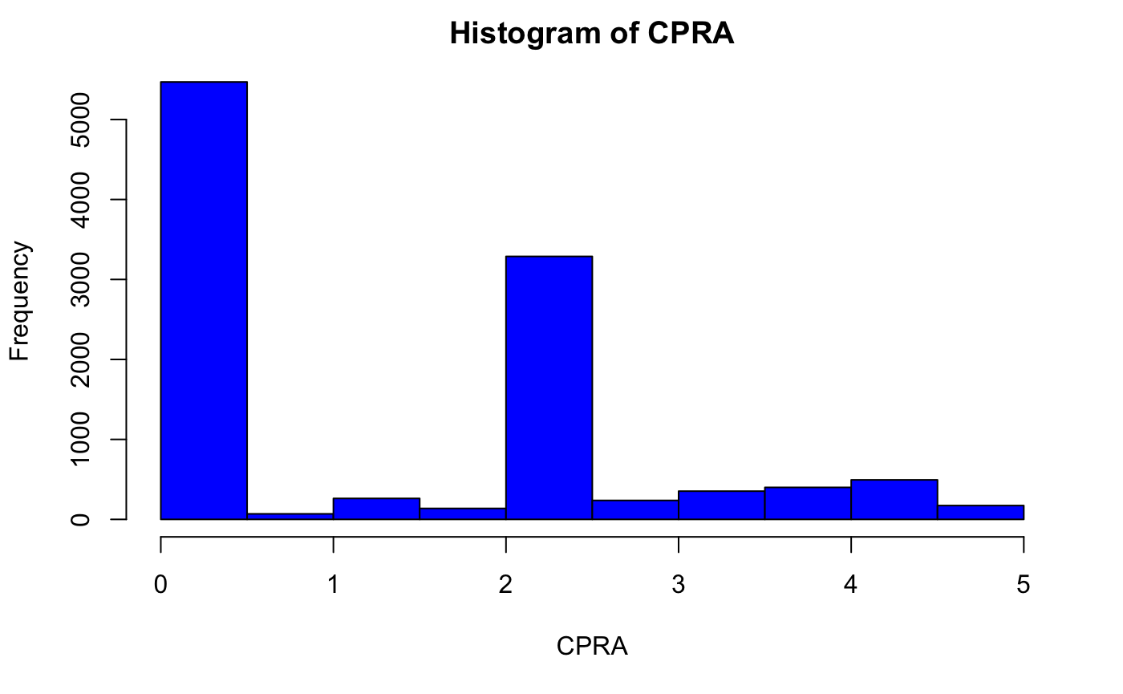
Example: CPRA variable before vs after log transform
CPRA (calculated panel reactive antibody): lab biomarker, percent, 0-100, patient have higher CPRA scores will have fewer potentially compatible donors.
We saw a spike in 0 and 15,we currently log transformed the variable (+1 if it’s 0).

Slide 10
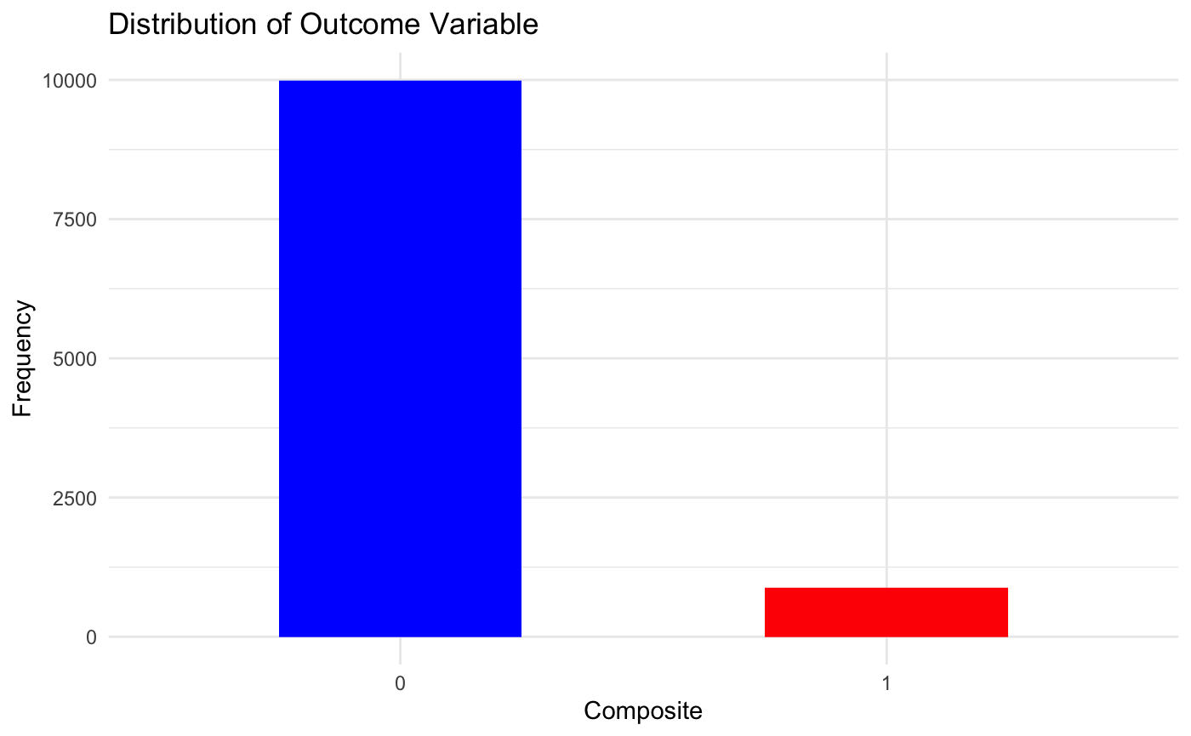
Outcome Variable Distribution
Recipient survived: 9995/10,882 = 0.92 or 92%
Recipient Died/graft-failure or retransplant = 0.08 or 8%

Slide 11
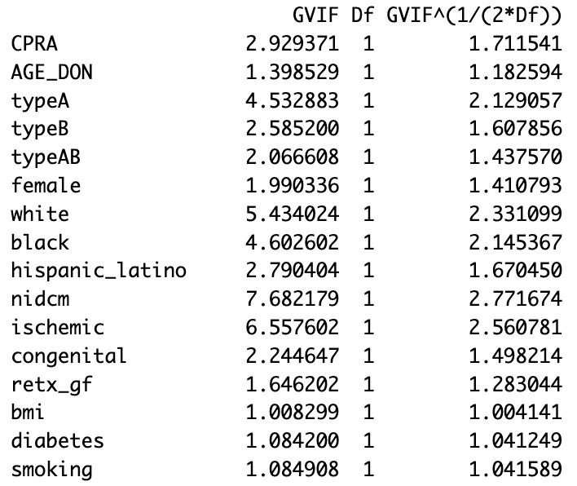
Multicollinearity
Multicollinearity refers to a situation in statistical modeling where two or more predictor variables in a multiple regression model are highly correlated.
Found & removed variables that are highly correlated with others.

Slide 12
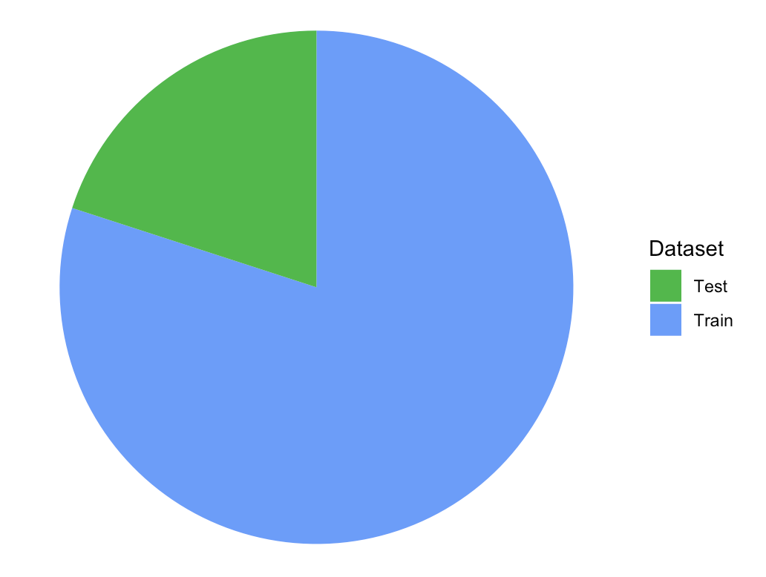
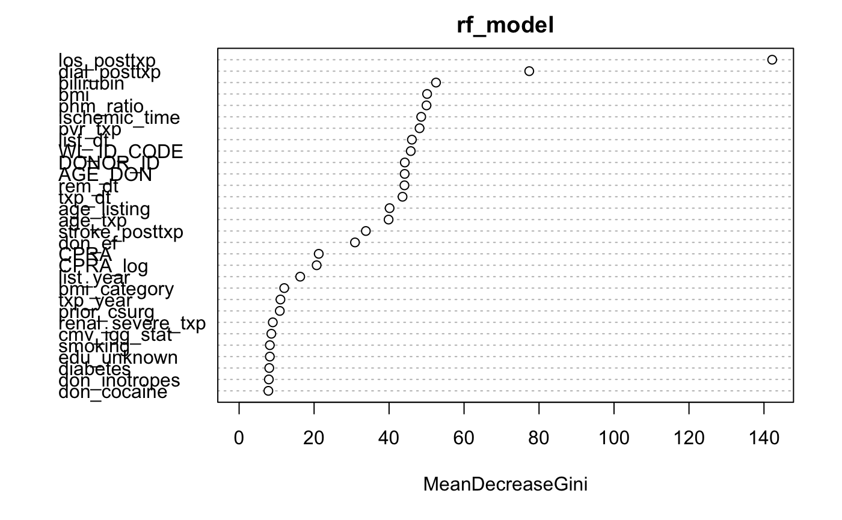
Modeling Approach:
Train test split
Train – 80% & Test - 20%
Model fitting on training set & Validation on Test set
Logistic Regression
The model was fitted using maximum likelihood estimation.
Achieved accuracy of 0.88 or 88%
Lasso Regression
Optimized the regularization parameter (lambda) through cross-validation.
The optimal lambda value for regularization was determined by the one that resulted in the minimum cross-validation error.
Accuracy of 0.82 or 82%
Random Forest
RF automatically handles feature selection and interaction during the training process.
Accuracy of 0.92 or 92%
Important variables that have the most influence on the rf model predictions

Slide 13
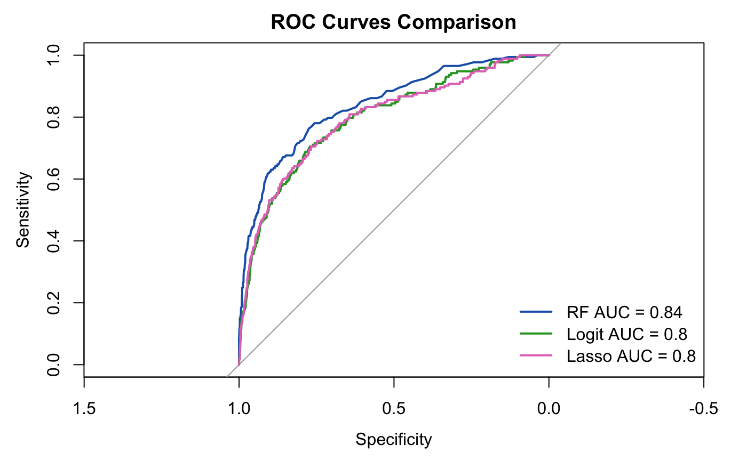
Model Performance (Area Under the Curve)
A higher AUC value indicates a model's better ability to distinguish between classes with greater sensitivity and specificity.
From this plot, suggests the Random Forest model outperforms the Logistic and Lasso Regression models, as evidenced by the highest AUC of 0.84.
Logistic and Lasso Regression models demonstrate similar performance, with both having an AUC of 0.8.

Slide 14
Conclusion & Lessons Learned
The high accuracy and AUC highlight the Random Forest's ability to handle complex interactions and its aptness for this dataset, making it the most suitable model for this analysis.
Provided a comprehensive understanding of different aspects of predictive modeling, from theoretical concepts to practical application.
Learnt multiple Imputation (MI) and mice techniques to handle the missing data.
In summary, this project reinforced the importance of conducting thorough descriptive analysis as the initial step in data analysis.

Slide 15
THANK YOU!!

